Slide 1
Minimizing Patient Acquisition Costs
Marketing Minute: Patients, Profits, and Practices
Jonathan, Kristen, Matt
5/16/2023

Slide 2
Today’s Speakers
Jonathan Reese
Vice President of Marketing
SocialClimb
Kristen Bryant
Vice President of Marketing
Clearwave

Slide 3
Agenda
Calculating Patient Acquisition Cost
The Cost Mix Analysis
Best Ways to Optimize Conversion

Slide 4
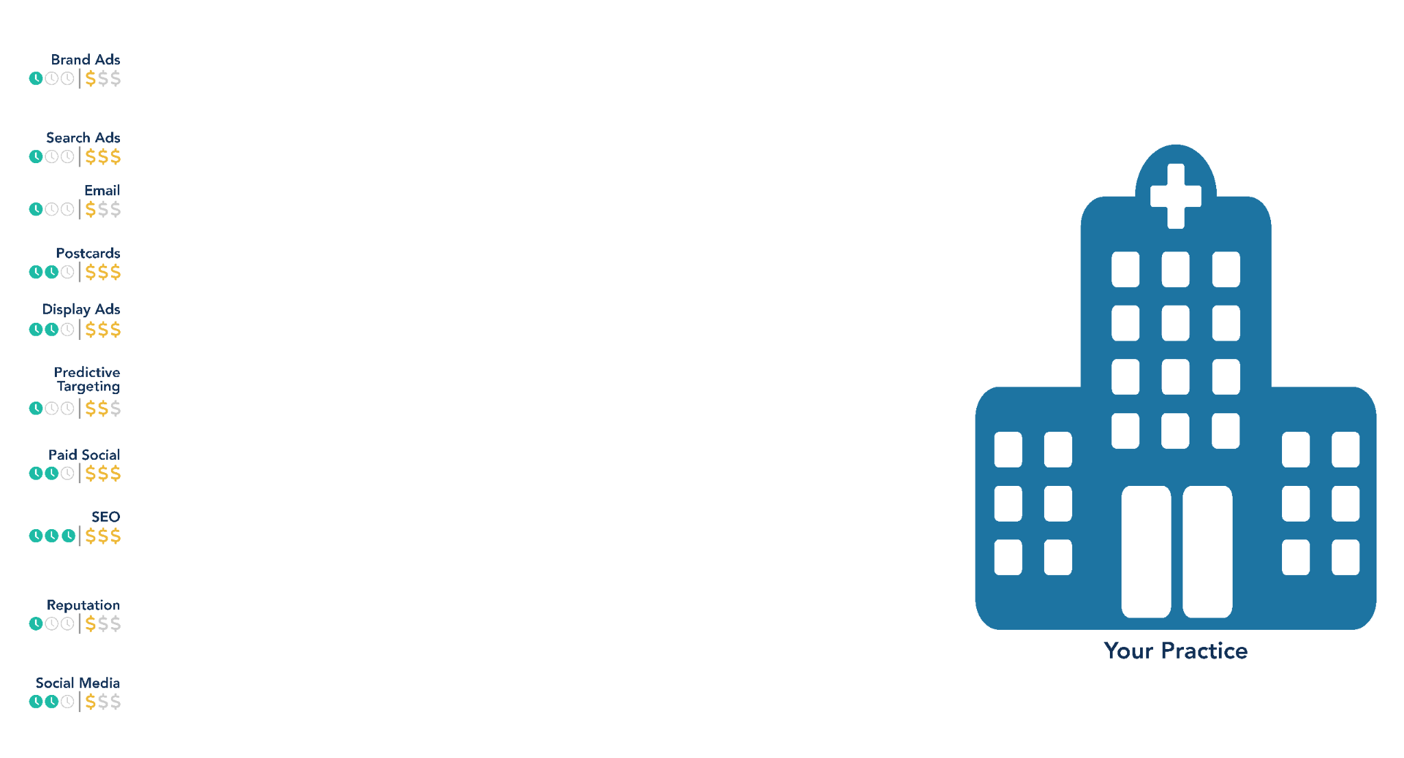
Constructs of Patient Acquisition Costs

Slide 5
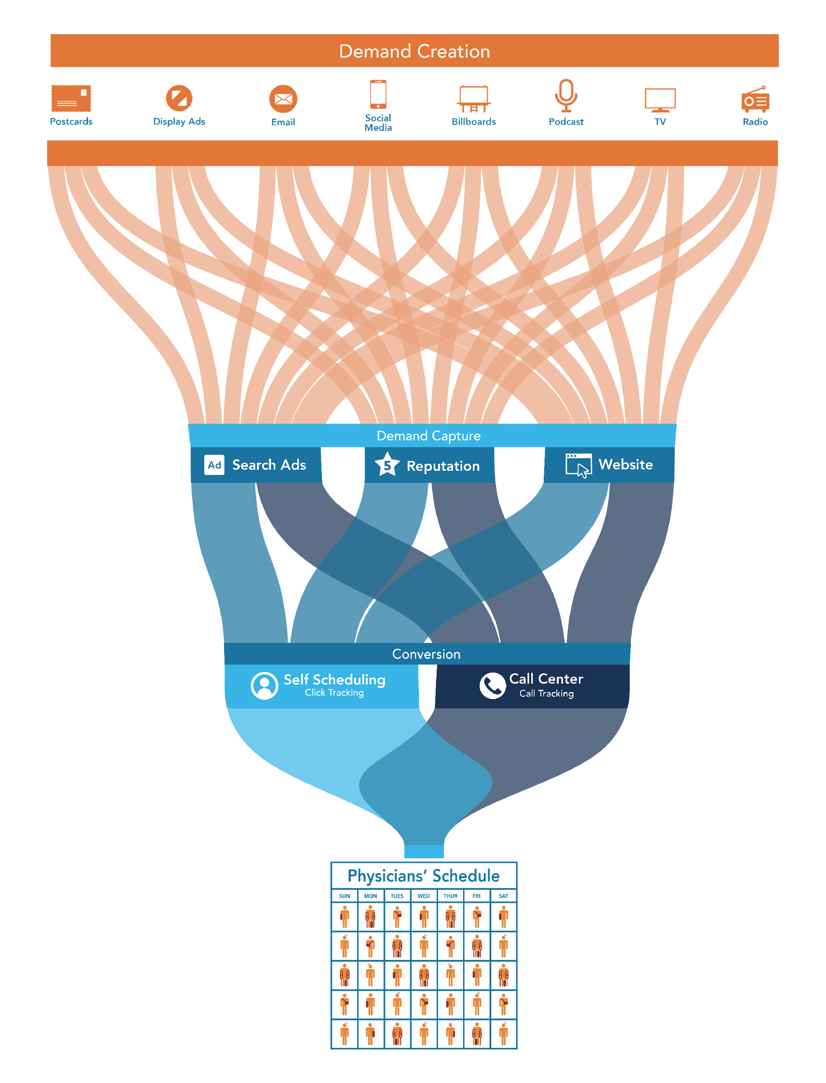
Demand Creation
Demand Capture
Conversion to Patient

Slide 6
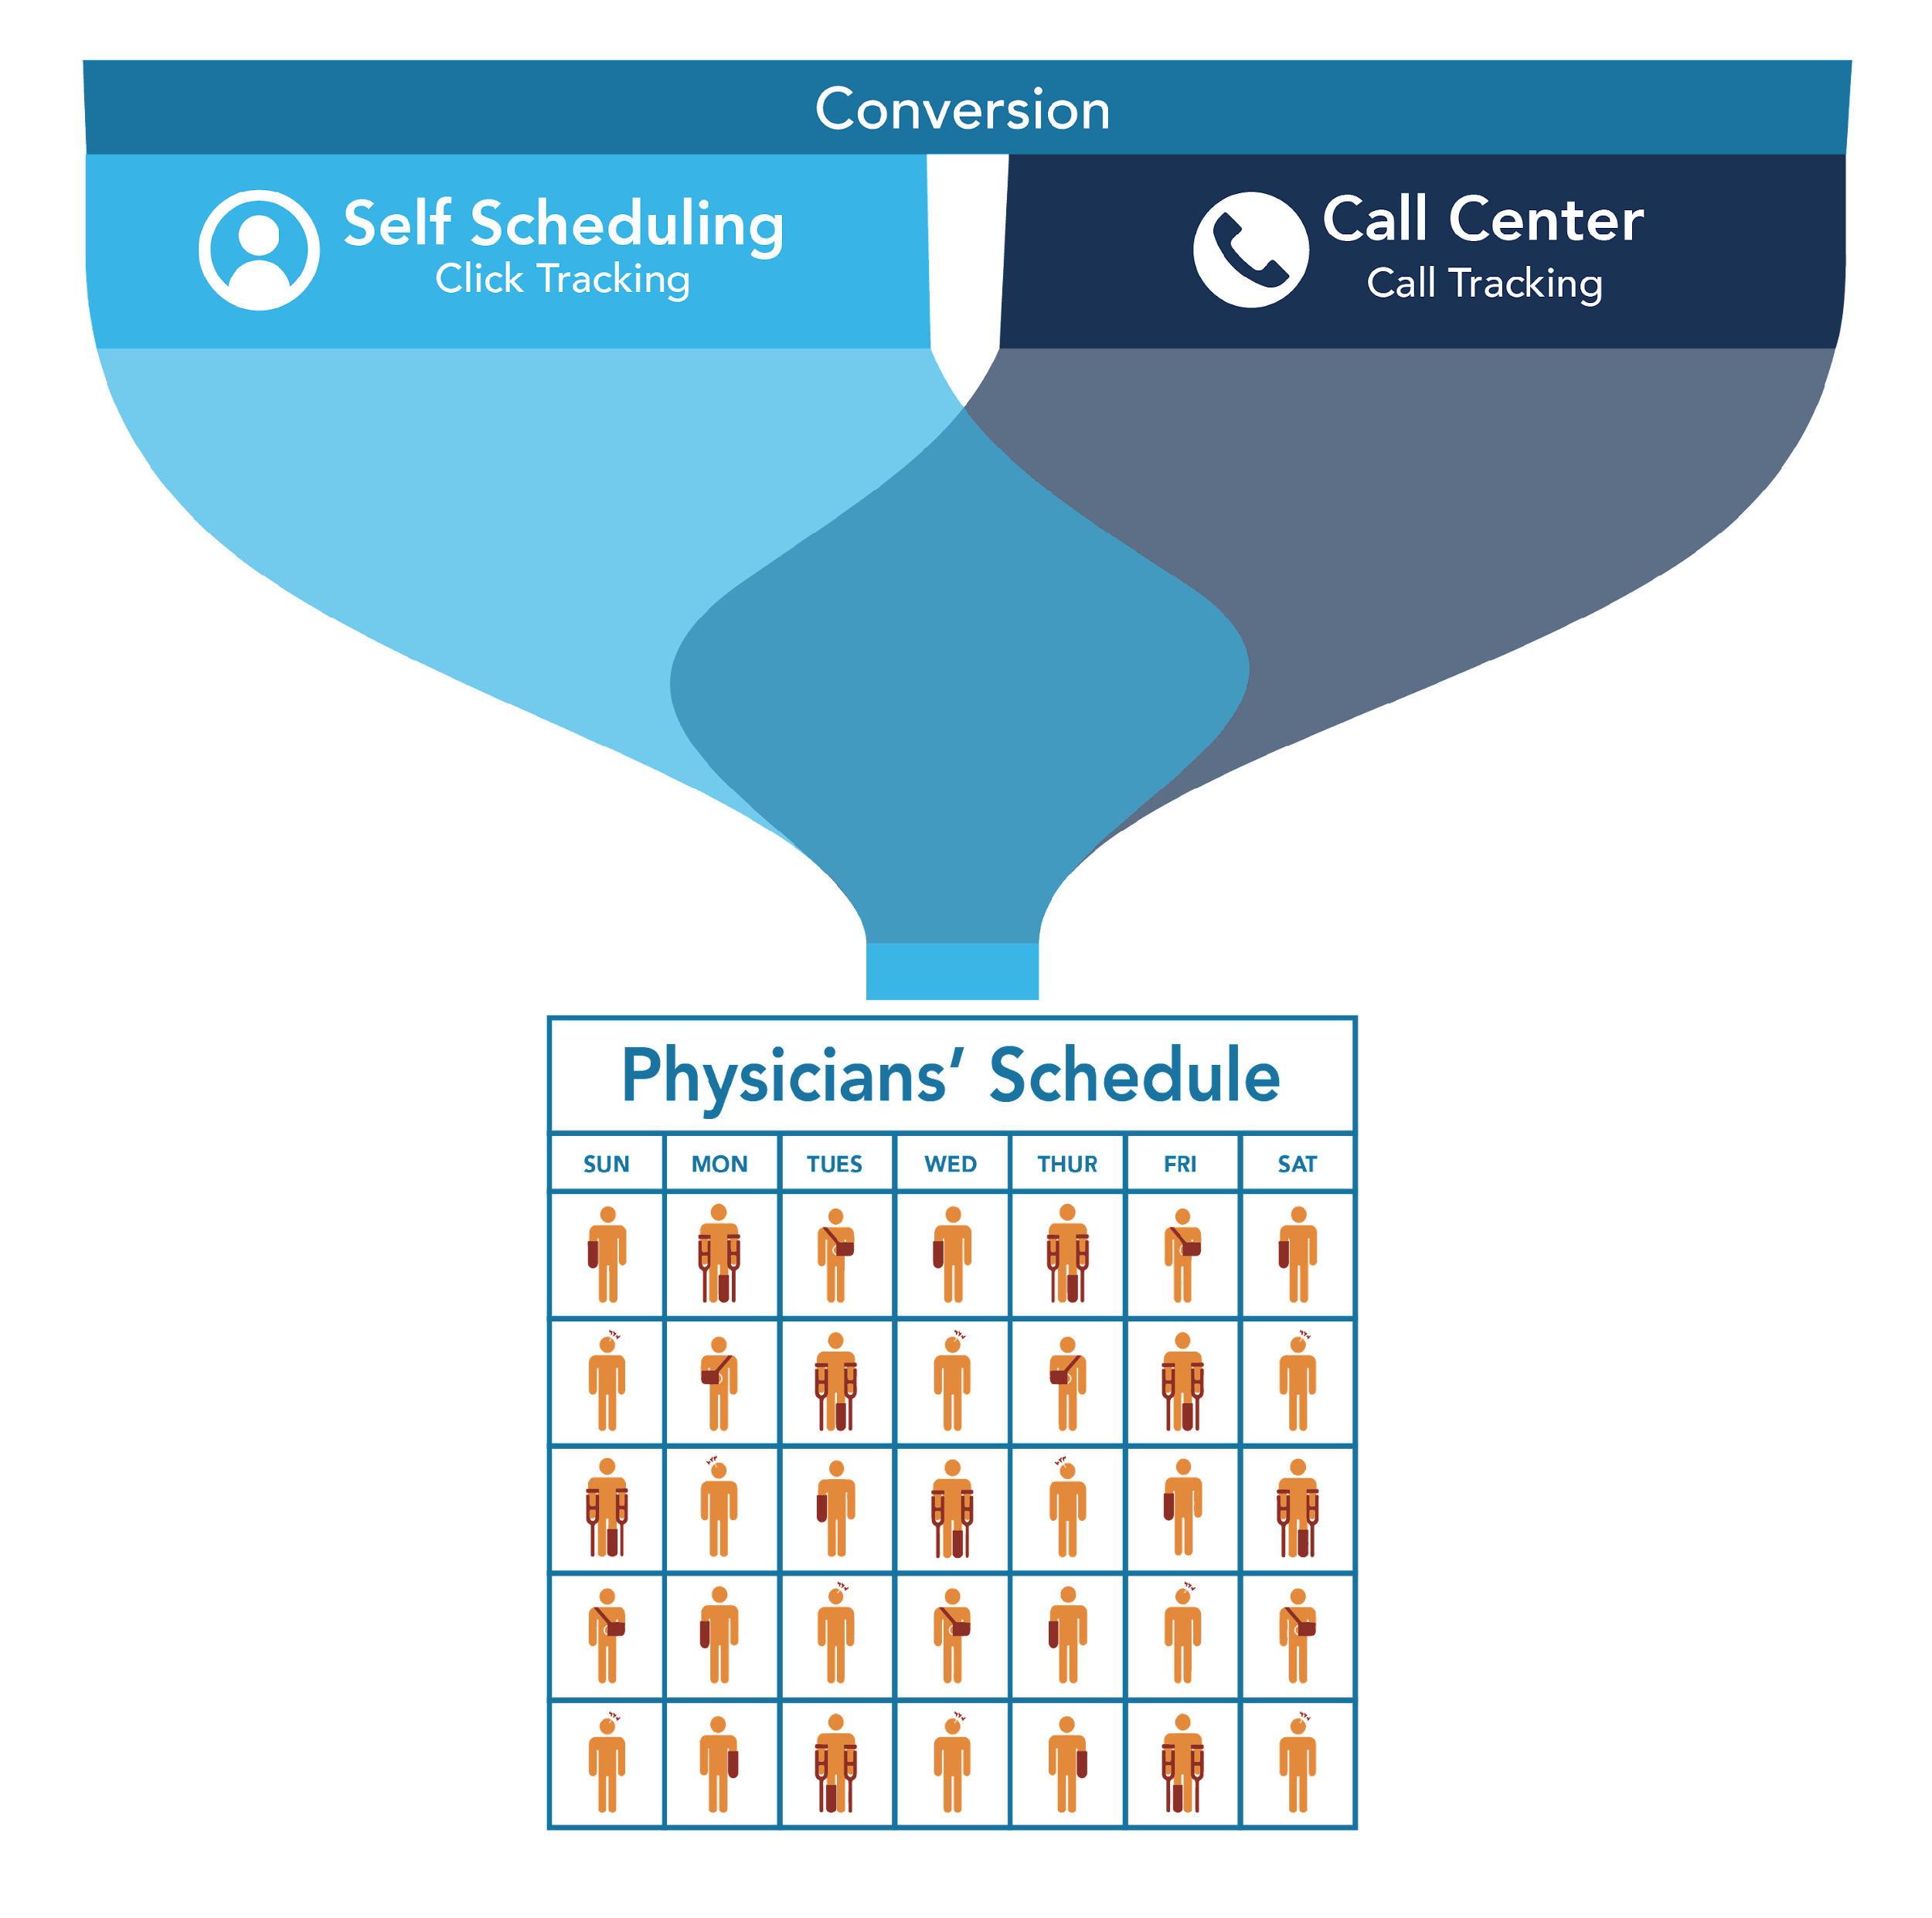
Conversion to Patient

Slide 7
Patient
Acquisition
Cost
(PAC)
Total Cost of Campaign + Acquisition
# of Patients Acquired from Campaign
https://socialclimb.com/patient-acquisition-cost-calculator/

Slide 8
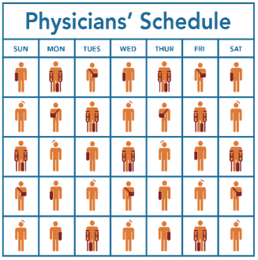
PAC
(
)

Slide 9
The Scheduling Experience That Increases Acquisition
90%
of patients would consider abandoning a provider that doesn’t offer
digital access
72%
of baby boomers say they use more technology now,
as a result of
the pandemic
90%
of millennials
book medical appointments
via the web or
a mobile device
Notes:
Consumers have been going online for years to become more educated about healthcare and healthcare decisions and now what we’re seeing more consistently is that consumers are demanding the same access they have in other areas of their life with their healthcare practices. They may even abandon a practice that doesn’t offer digital access. The demand for ease and choice in online scheduling as really picked up over the last few years, across the age spectrum. Consumers are used to instant access, they can book a flight on the go, order dinner to their door from their phones - it’s time healthcare provide this same on-demand access. Practices who are using “request an appointment’ are missing out on consumers who willing to book an appointment directly from your website. Don’t stop your Patient Acquisition Cost calc at a dead-end Call-To-Action button.

Slide 10
The Scheduling Experience Today
Directed to a phone number on the website
to call to schedule an appointment.
Inefficient for patients AND staff Limited to office hours
Costly to scale
Patient A
Fills out a ”Request an Appointment” form on
practice website. Waits for staff to return the call.
Inefficient for patients AND staff Decreased patient acquisition
Costly to scale
Patient B
Books an appointment online, uploads insurance information. Information sent to PM System.
Efficient for patients
AND staff
Patient C
Notes:
Let’s take a look at 3 patient examples. Patient A finds a phone number on your website, calls to schedule an appointment. On average it takes a patient 8+ minutes to schedule an appt over the phone and in many cases longer depending on time at which they call. This is inefficient for patients and staff, and requires staff to scale as your practice grows and increases your Patient Acquisition Cost calculation by adding in staff resources to the equation.
Patient B, completes a “request appointment’ form on the website and has to wait for a call back. Practice call volumes are 24% higher when direct online patient self-scheduling is not available and still requires staff resources to review these forms and make return calls to patients. This is what I like to call a dead-end CTA. You have a captive patient, eager to schedule an appointment, and although better than no form on your site, you are missing out on the full conversion potential here, and once again increasing your PAC.
Patient C, visits the website and is able to self-schedule online, can upload insurance card and driver's license. This information is sent directly to the PM System and your practice can see whether the patient has verified insurance and what the co-pay will be. This requires no staff to intervene to schedule, and enables patients to find an appointment at a time convenient for them, 24/7. You have a full conversion right to your providers schedule, and had no staff required to intervene. 77% of patients surveyed in a recent patient experience survey said they ability to schedule online was of key importance to them.
Think about your own workflow, if you are a Practice A or Practice B - how many patients request an appointment, but never get scheduled for one?

Slide 11
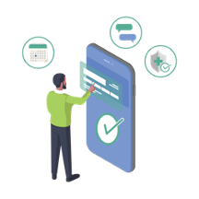
A Proven Patient Acquisition Strategy
Streamline marketing efforts with a cost-efficient approach.
Use self-scheduling solutions to bring in patients 24/7, without burdening staff.
See more patients (and increase revenue!)
Stand Out From Competition
Win New
Patients
Provide
More Care
Notes:
Ultimately, online patient scheduling is about creating a better patient experience, expanding your reach and allowing your practice to be more accessible to the consumers you want to serve. As you look to market to different patient populations to increase the scope of your reach, online scheduling is a key strategy. Online patients have higher capture rates and online scheduling rates than other patients, enabling you to grow your practice and increase revenue at a higher rate than you have to grow staff to support your growth rates.
By integrating self-service scheduling into all of your online and offline marketing channels, you can optimize conversions.

Slide 12
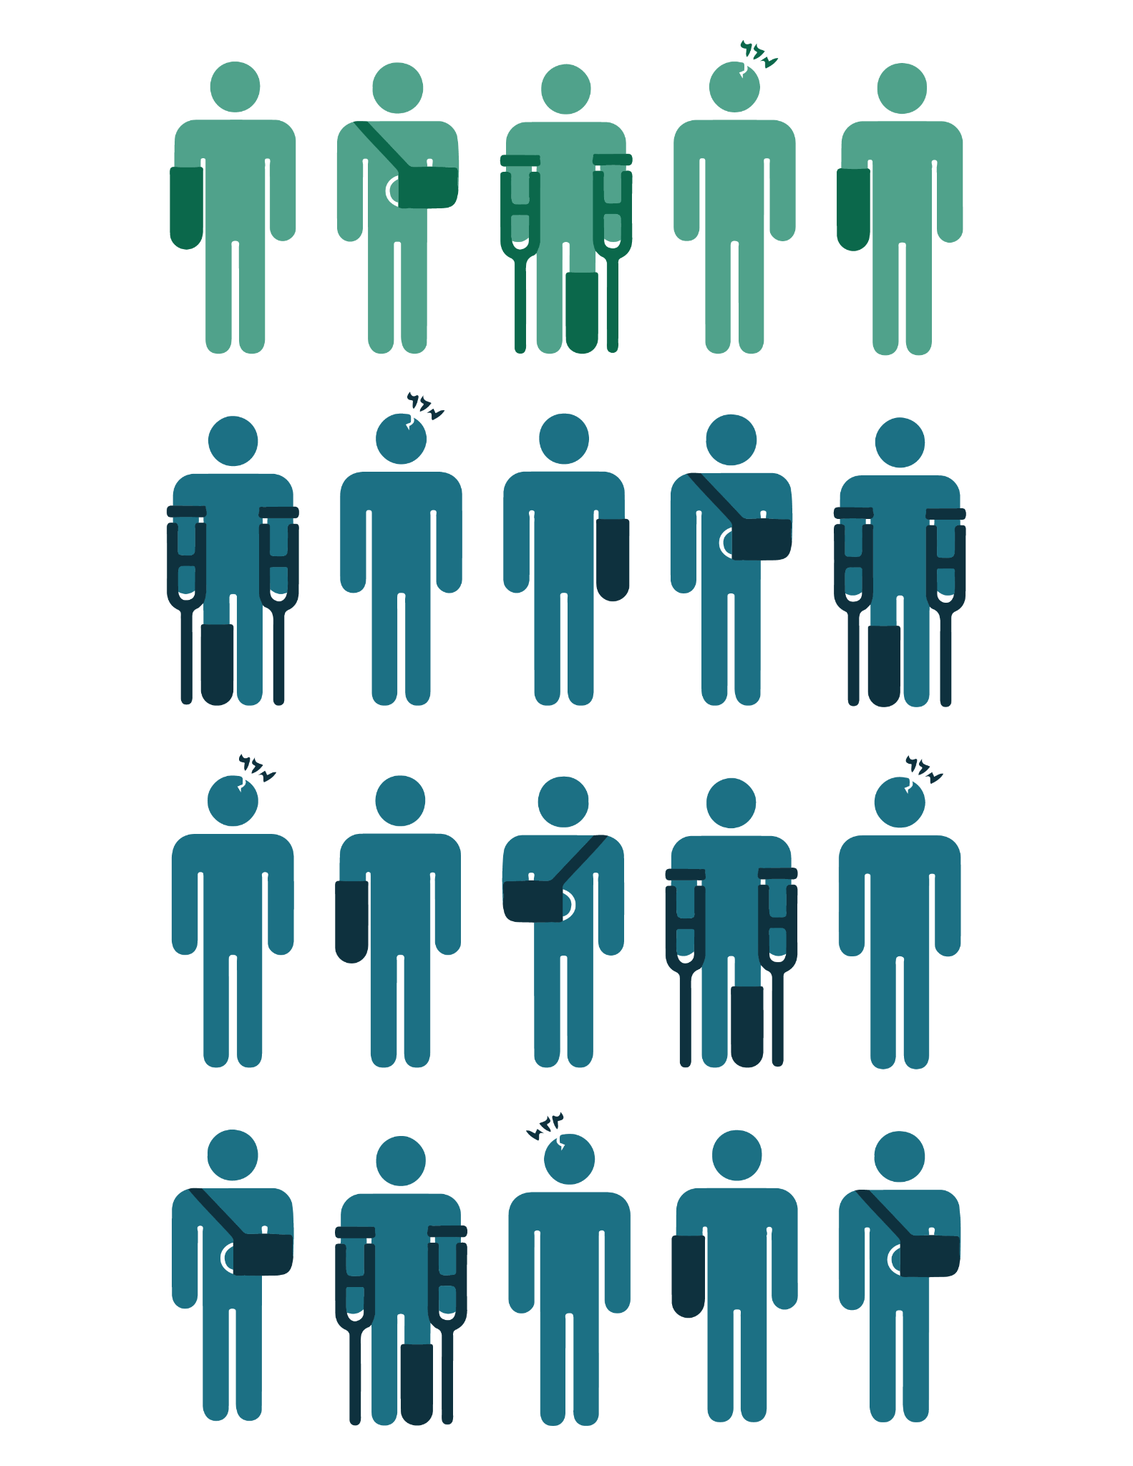
Online Scheduling Can Help Maximize Revenue
24%
new patients
scheduled online
76%
established patients
scheduled online
One online scheduling
client saw a
590%
increase in new
patient acquisition
68%
appointments made
in advance
32%
made last-minute appointments
47%
appointments booked
after hours
Notes:
Let’s take a look at a handful of case studies and results practices saw after implementing self-service scheduling to their practices.
One clients saw nearly a 6 fold increase in new patient acquisition after implementing the online scheduling tool.
Other clients have seen increase in advanced appointments, and last minute appointments being accommodated.
Many of these practices moved to online scheduling in the hopes to attract new patients, which it definitely does, but what's also interesting is that adoption by established patients can be quite high as well.
This is a patient experience lift for existing and new patients alike. Not only does this help improve conversions, but has additional benefits like an increase in practice reputation and reviews, helping to attract even more clientele.

Slide 13
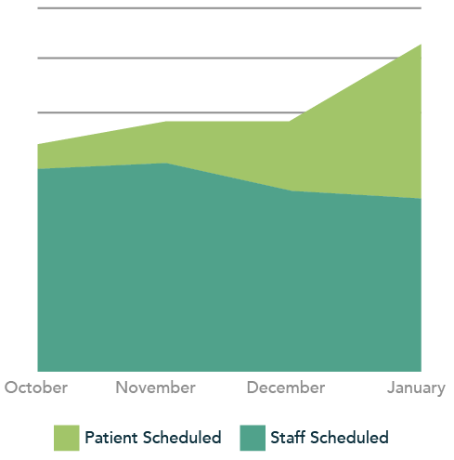
Keys to Success of Implementing a Digital Strategy
Balance the core needs of your practice while keeping things simple for the patient
The goal is to create an experience that patients embrace and reduce staff effort
If it’s easy to use, patients will flock to the solution, which will yield growth in revenue and reduction in staff effort and cost
Remember: Done is far better than perfect!
Notes:
And finally, we understand that digital adoption can be a bit daunting for a practice. Implementing new technology and training staff can seem out of reach for organizations, but it’s really about prioritizing what you need for your organization and keeping things simple with a partner that can help you through that transformation. What is your goal, and then focus on how do you deliver that to your patient in the simplest way. Keep the patient experience at the forefront of what you’re building, what's meaningful and relevant to them to make sure their experience is the most seamless as possible. Think of it like an OpenTable reservation, you can do it in 45-60 seconds. Of course the care you deliver is much more complicated than making a dinner reservation, but consumers don’t understand those complexities. Find a partner who is equipped to provide white-glove service to help you implement and onboard new technology and remain a partner who you can easily reach throughout the lifetime of your partnership.
A client, Thomas Eye Group provided the data this graph is illustrating. They took the approach that done is better than perfect when needing to find the right solution to help with their explosive growth. They implemented self-service scheduling in October, and by January growth was picking up significantly and doing it in the way they hoped which was more appointments being scheduled by patients than by staff, while still growing number of appointments overall.
Scheduling isn’t just a patient engagement tool, it’s a patient revenue growth strategy to help your practice scale to new heights.

Slide 14
Q&A
Notes:
And now I’ll turn it back to Matt.

Slide 15
Part II
How to Measure the Long Term Value of Patients
May 23rd | 12 PM (et)
Register Now on LinkedIn!

Slide 16
Thank You

